Slide 1
BADM 554 FINAL PRESENTATION
Team B02

Slide 2
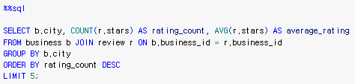
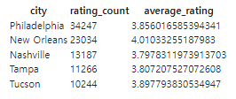
MINI PROJECT 1
Q1. Which cities have the highest number of reviews and what are their average ratings?
Goal: Get information about opening a successful and outstanding business.
• Used to determine the location where to open the business
• Among 5 cities with the highest rating counts, Nashville had the lowest average rating
By. Team B02
Date. Dec 6, 2023

Slide 3
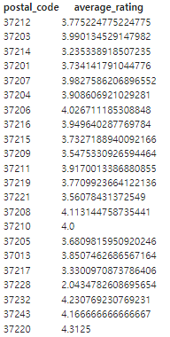

MINI PROJECT 1
Q2. What is the average rating of businesses in Nashville by postal code?
• Within selected city (Nashville) what are business ratings by postal code.
• Determine in which area businesses are having poor performance.
By. Team B02
Date. Dec 6, 2023

Slide 4
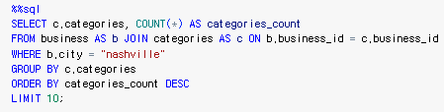
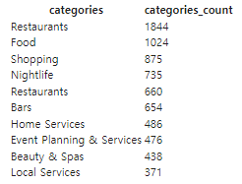
MINI PROJECT 1
Q3. What is the number by business categories in Nashville?
• Count the number of business categories in the city of Nashville.
• Helpful to decide what type of business we are going to open.
By. Team B02
Date. Dec 6, 2023

Slide 5
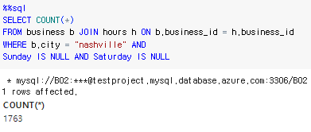
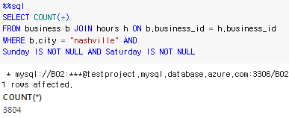
MINI PROJECT 1
Q4. Among businesses in Nashville, how many of them open for the weekend and how many of them do not?
• Compare counts of businesses those are open during weekend and those are closed during weekend.
• Useful to determine whether we will open business during weekend or not.
By. Team B02
Date. Dec 6, 2023

Slide 6
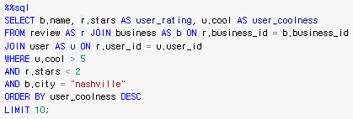
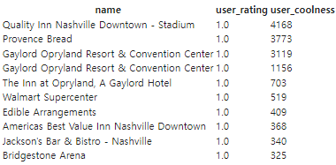
MINI PROJECT 1
Q5. What are businesses that received rating 1 from the “cool reviews”
• Find businesses that received 1 star from the review that is “cool”.
• Investigate their business strategies and try to avoid it so that our business successfully become “cool”.
Key Skills Developed
- Manipulating Json file on Python
- Utilizing database to store and load data
- Building SQL queries based on business goals
By. Team B02
Date. Dec 6, 2023

